Slide 1

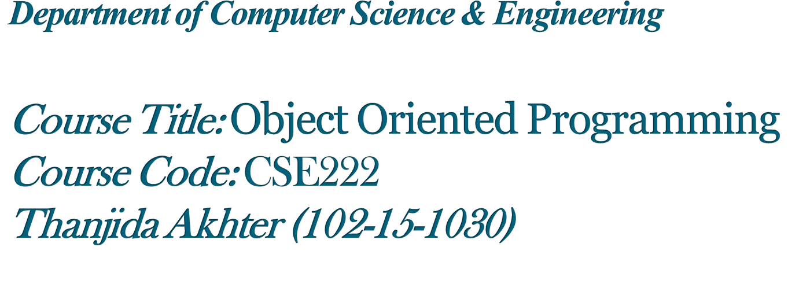

Slide 2


Slide 3


Slide 4



Slide 5



Collections
CD
DVD

Slide 6


Slide 7


Slide 8


Slide 9

Class cd{
int ID;
char name[15];
public:
int rent;
void getdata();
void searchcd();
cd( ) {rent=0};
};
Class dvd{
int ID;
char name[15];
public:
int rent;
void getdata();
void searchcd();
dvd(){rent=0};
};

Slide 10


Slide 11
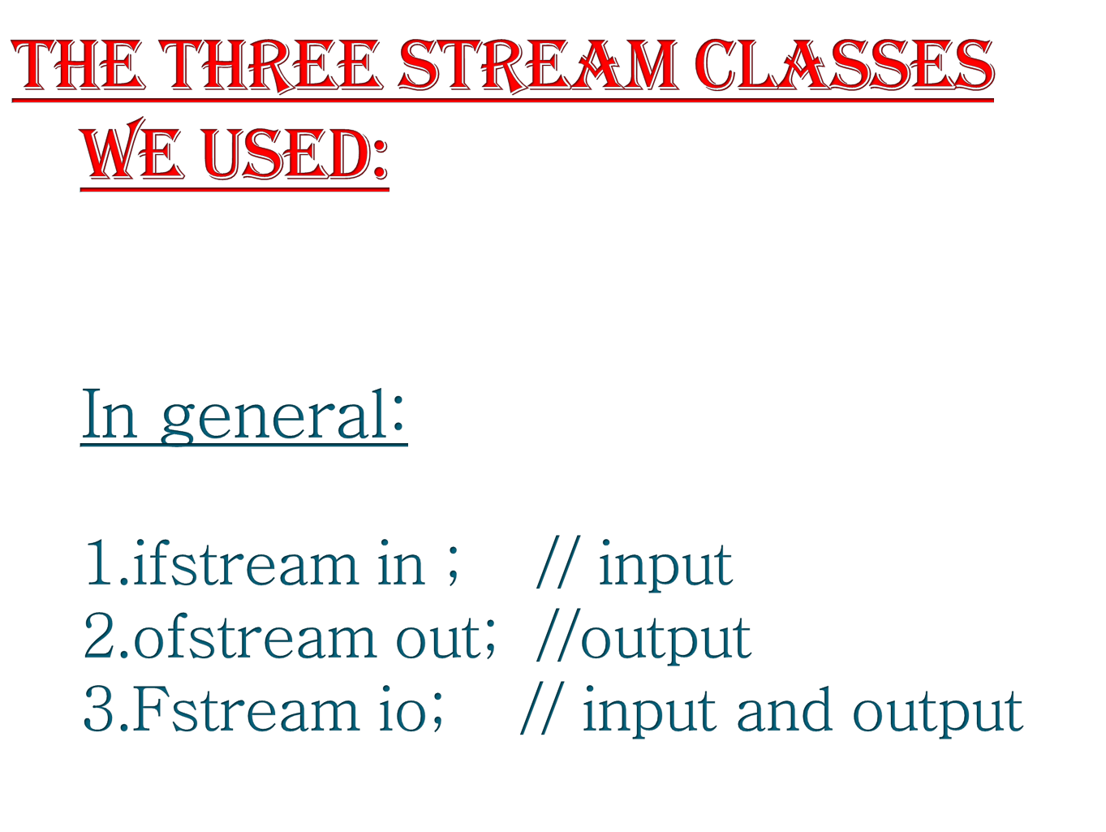

Slide 12

After creating a stream we should be capable of opening a file by using open().
In general:
1.void ifstream::open(const char*filename,
openmode mode=ios::in);
2.void ofstream::open(const char*filename,
openmode mode=ios::out|ios::trunc);
3.void fstream ::open(const char*filename,
openmode mode =ios::in|ios::out);

Slide 13


